Slide 1

Android Lesson 1: How To Android
By: Josh Chang
Notes:
Introduce yourself
Ask who has experience

Slide 2
What Will We Learn?
Week 2: How to create a basic app
Week 3: Intents how to go to different pages
Week 4: ActionBar to go to different pages
Week 5: How to debug: Log.d, Toast and music!
Week 6: BREAK
Week 7: DB 1
Week 8: DB 2
Week 9: Interacting with online servers
Week 10: BREAK

Slide 3


What Do You Want to build?
Notes:
Name
How much experience do you have in programming
What you want to learn from the class

Slide 4
About Android
It is (partially) Event Driven Programming
Too many things to learn: only pick and choose some important things for this class
Basic knowledge of Java or basic programming knowledge is needed

Slide 5


Let’s Create Our First Project!
Notes:
Pull out Android Studio and start a new project

Slide 6
Setting Up Our First Project

Slide 7
New Project Notes
Company Domain – Unique identifier for the play store. You don’t need to own the domain
Minimum SDK – The minimum version your phone can support. Google updates it everyday. Recommended min: 16
http://developer.android.com/about/dashboards/index.html
Activity – The Java file where you put your code that allows you to control your layout and create your own functionality
Layout – The XML file where you create the appearance of the app

Slide 8
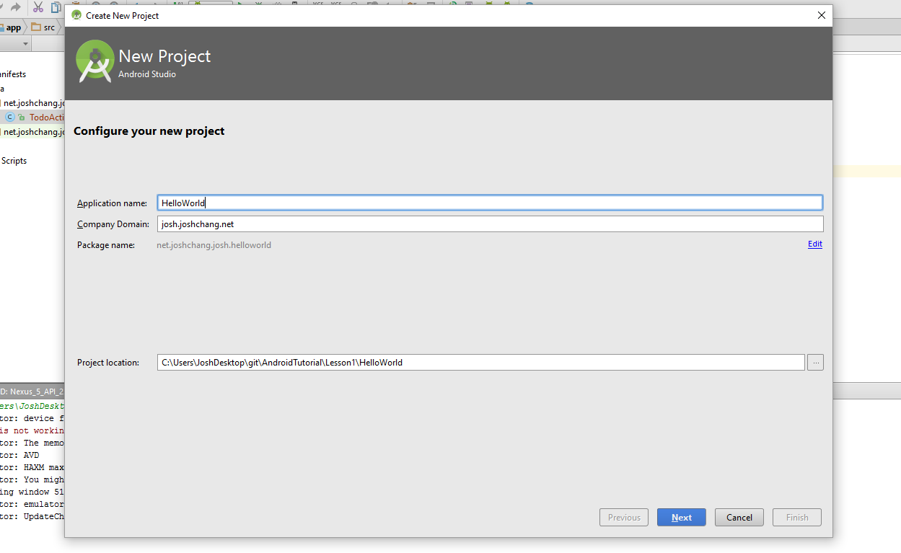
New Project

Slide 9
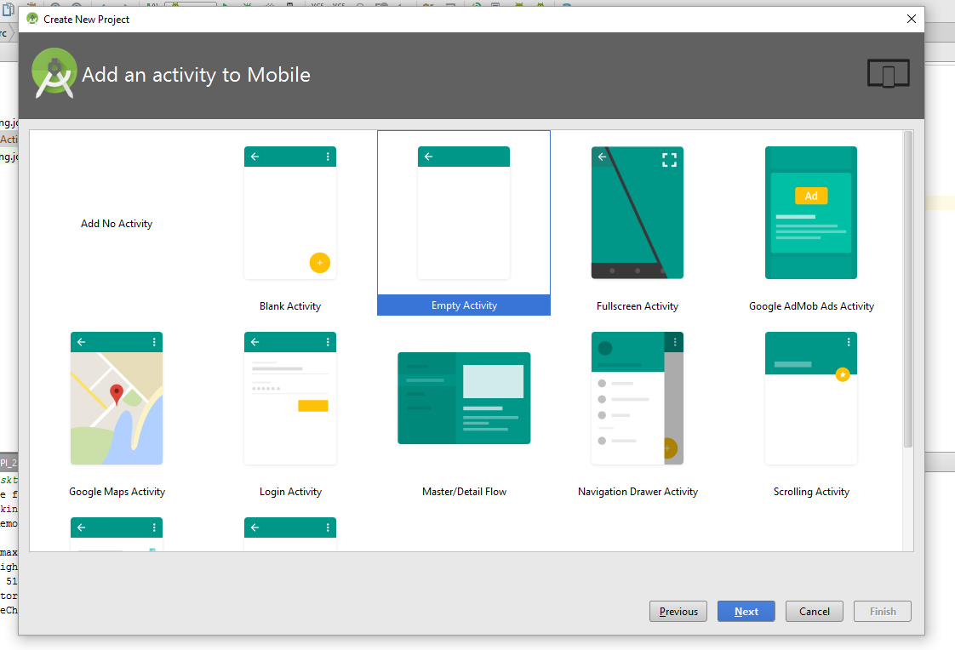
Select Activity

Slide 10
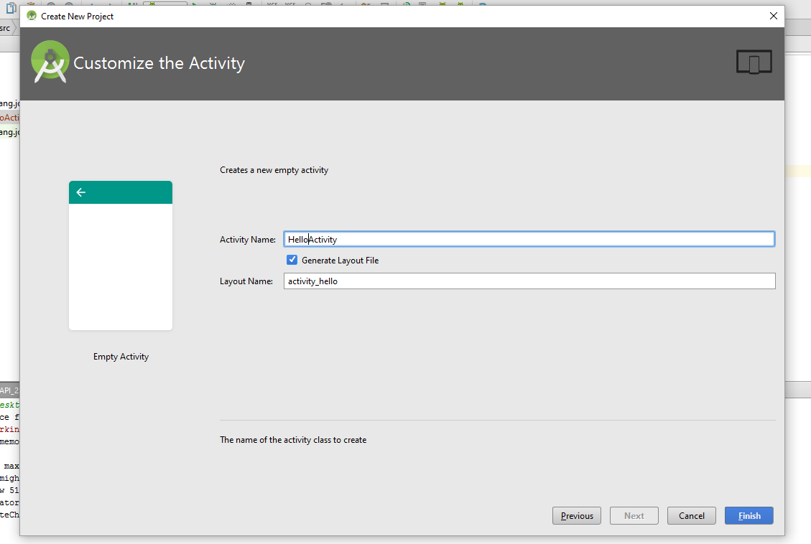
Create Our Activity
Layouts – XML files that create the UI for our app
Activity – Java files that allows us to interact with our UI in code

Slide 11
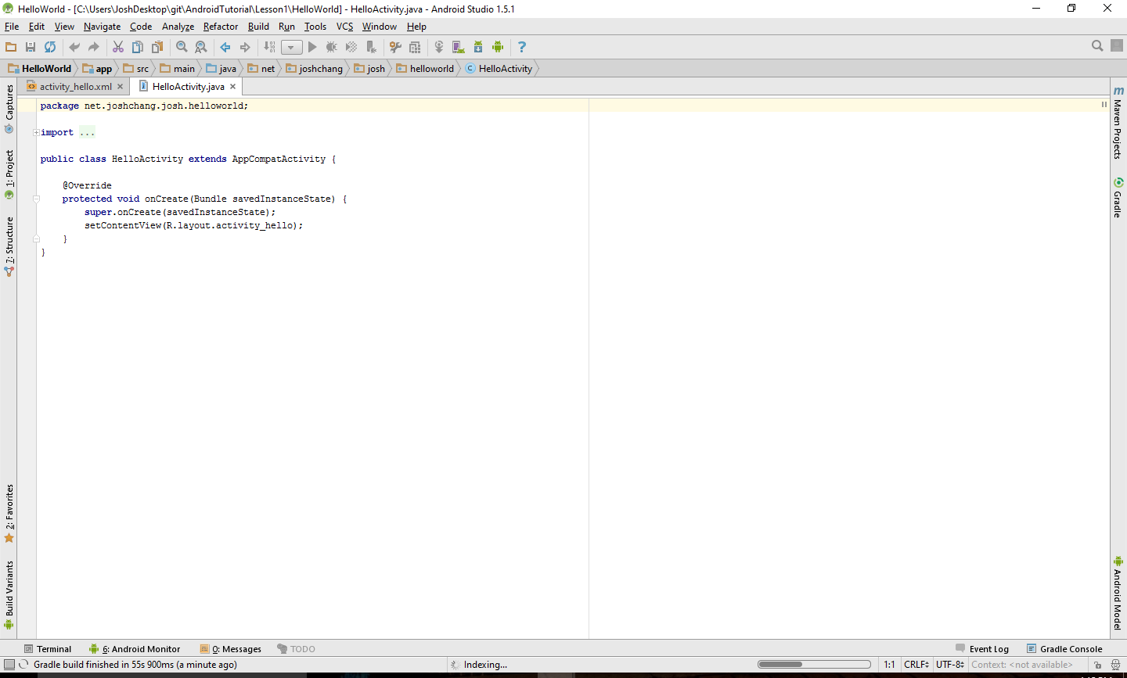
Created Project
Note: give Gradle time to build

Slide 12
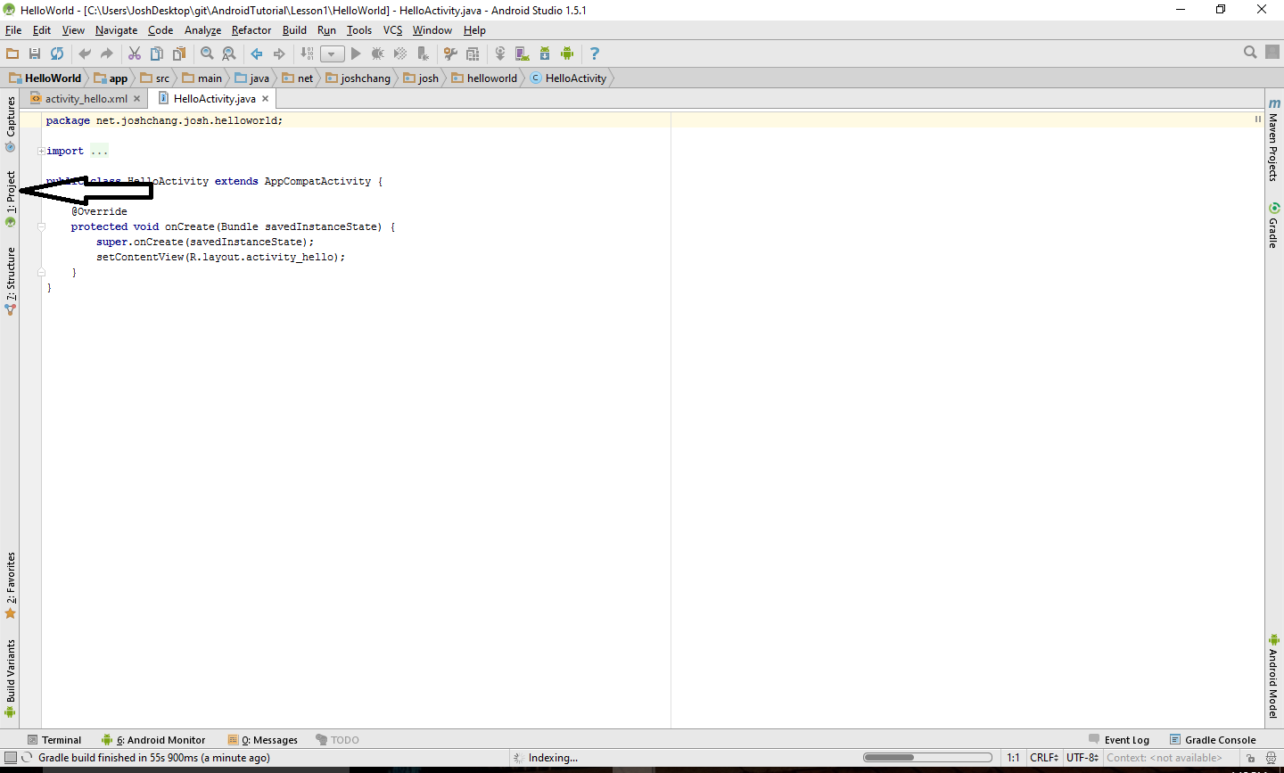
Select Project Folder

Slide 13
Exploring Our File Directory

Slide 14
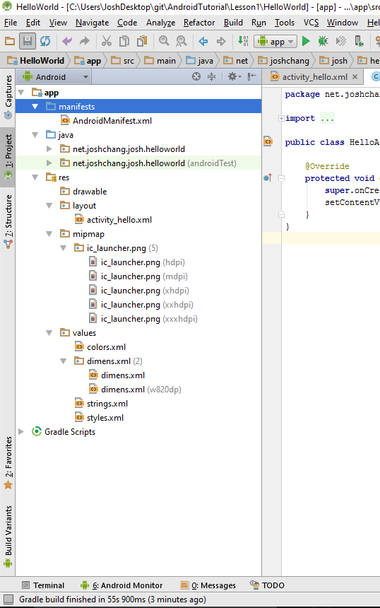
File Directory

Slide 15
Android Studio File Structures (Part 1)
manifests – Contains AndroidManifest.xml which is your settings. Includes: devices permissions, sdk, global style setting
java – Contains two folders. One is your actual code and the other is test code
res – Resources. Put all of your assets in here

Slide 16
Android Studio File Structures (Part 2)
res – Resources. Put all of your assets in here
drawable – where you put your images
layout – where you put your xml files that define how your activity will look
mipmap – where you put small images, specifically icons
values – defined variables that you can call anywhere. Handy if you have a large code base
colors.xml –user defined global variables for color
strings.xml – user defined global variables for string. Useful for multi-language
Styles.xml – user defined global variable for layout styles.

Slide 17
Playing with our Layouts

Slide 18
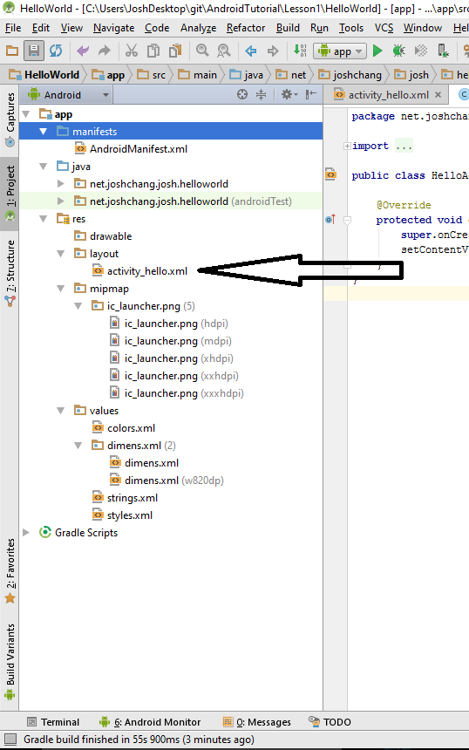
Select Layout File

Slide 19
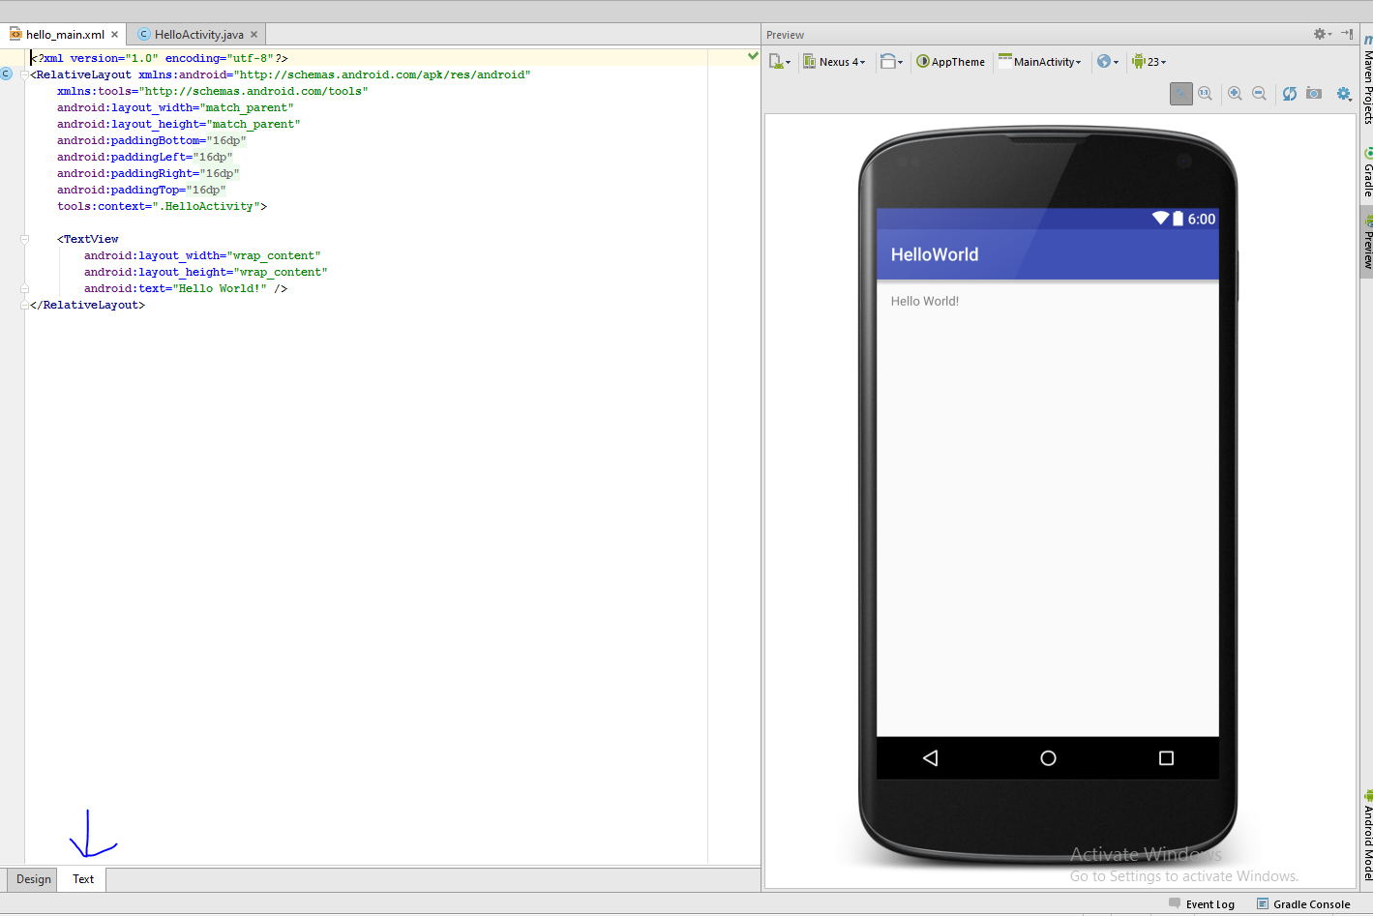
XML Text

Slide 20
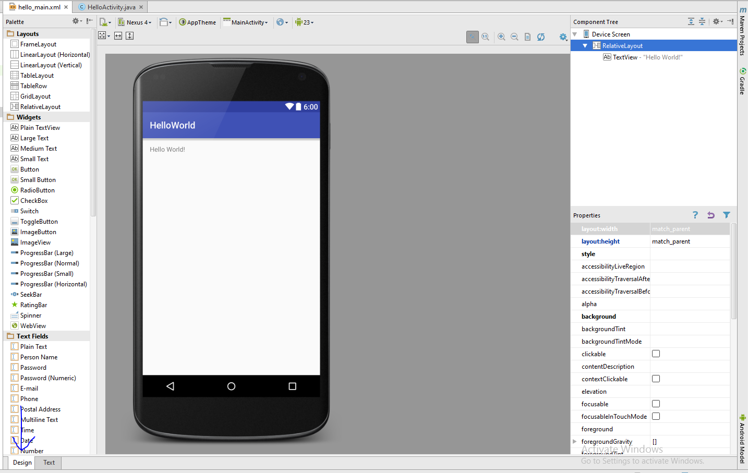
XML Design Mode
Easy drag and drop interface

Slide 21
Side Note: if there are errors…
If the design has error messages and the design mobile isn’t showing up…
If the error gives you a clear cache option. Click it
Otherwise go to File -> Invalidate Caches / Restart… and clear your cache and restart

Slide 22
Understanding Our Layout Components

Slide 23
Linear Layout Vs. Relative Layout
Layout components are used to store widgets inside of them. The 2 most common ones are:
Relative Layout – The widget’s location can be placed anywhere inside the layout as you wish, relative to other objects
Linear Layout – The widget’s position will always be forced to be adjacent with each other

Slide 24
Basic Widgets
TextView – Used to display texts
Button
EditText – Referred as Text Fields in Android’s Design picker
Radio Button
Check Box

Slide 25
Important Component Properties
layout_height and layout_width – assigns the height and width. Use:
match_parent to expand to the outer layer (the device size, the layout a widget is in)
wrap_content to expand to the minimum of how big your widget would be
Enter a specific dp (dimension pixel)
id=“@+id/<my id>”- create an id that would be used to identify your widgets
layout_margin<direction> - Moves your widget in <direction> in dp
layout_padding<direction> - As oppose to moving your widget, you add “padding” space for contents of the widget
text – Sets text to appear on your widgets

Slide 26
Important Relative Layout Properties
You can use these attributes in any widgets that are inside a Relative Layout:
Layout_above, layout_above, layout_alignRight, layout_alignLeft: give an id of a widget and you’ll move the current widget next to the other widget

Slide 27
Creating Our First App Layout

Slide 28
Goal
Goal – A simple app that will display texts the user typed after they clicked a button
What we need:
TextView to display the text
EditView to let users enter the data
Button to let users add the text to our TextView
Note: We can delete the existing TextView

Slide 29
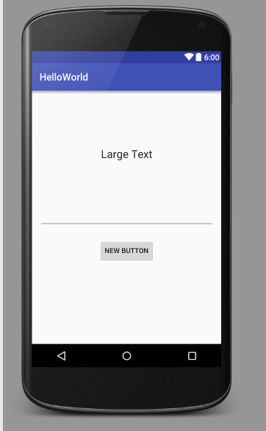
What ou layout looks like
<?xml version="1.0" encoding="utf-8"?> <RelativeLayout xmlns:android="http://schemas.android.com/apk/res/android" xmlns:tools="http://schemas.android.com/tools" android:layout_width="match_parent" android:layout_height="match_parent" android:paddingBottom="@dimen/activity_vertical_margin" android:paddingLeft="@dimen/activity_horizontal_margin" android:paddingRight="@dimen/activity_horizontal_margin" android:paddingTop="@dimen/activity_vertical_margin" tools:context=".HelloActivity"> <TextView android:layout_width="wrap_content" android:layout_height="wrap_content" android:textAppearance="?android:attr/textAppearanceLarge" android:text="Large Text" android:id="@+id/textView" android:layout_alignParentTop="true" android:layout_centerHorizontal="true" android:layout_marginTop="99dp" /> <Button android:layout_width="wrap_content" android:layout_height="wrap_content" android:text="New Button" android:id="@+id/button" android:layout_alignParentBottom="true" android:layout_centerHorizontal="true" android:layout_marginBottom="148dp" /> <EditText android:layout_width="wrap_content" android:layout_height="wrap_content" android:id="@+id/editText" android:layout_centerVertical="true" android:layout_alignParentRight="true" android:layout_alignParentEnd="true" android:layout_alignParentLeft="true" android:layout_alignParentStart="true" /> </RelativeLayout>

Slide 30
Learning About Android Code

Slide 31
HelloActivity.java
Keep your own package the same
Our class extends AppCompatActivity which allows us to create our own own Activity to build Android Apps
Note: A lot of methods we will be using will all be inherited from our class. It’s what makes Android works
We override the onCreate() method to add our own code when our app first opens.
What else is there…?
package net.joshchang.josh.helloworld; import android.support.v7.app.AppCompatActivity; import android.os.Bundle; public class HelloActivity extends AppCompatActivity { @Override protected void onCreate(Bundle savedInstanceState) { super.onCreate(savedInstanceState); setContentView(R.layout.hello_main); } }

Slide 32
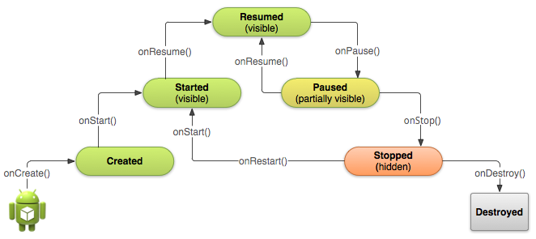
Android Life Cycle

Slide 33
REMEMBER!
When you override any of the Android Life Cycle methods. You have to call the super class method. Otherwise your app might not work!

Slide 34
How To Access Your Layouts
Two things that needs to be done
1. setContentView(R.layout.<layout_name>);
2. findViewById(R.id.<id of your widget>);
Returns a View which we need to cast into our widget type. Ex:
Button button = (Button) findViewById(R.id.buttonId)
Note: R is a shortcut to your res folder.
Both methods are inherited from our Activity class and we can call them anytime

Slide 35
Important TextView Methods
setText(“text”); – Sets your label to have the text inside. Usually labels are just there to display information.

Slide 36
Important EditText Methods
getText().toString() – getText() returns an Editable class that is your text, just convert it to a String to get the value
setText(“text”) – Change the text of your EditText widget.

Slide 37
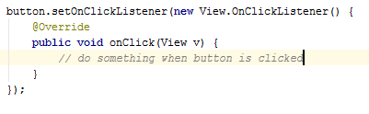
Important Button Methods
Adding a listener for when the user clicks on the button:

Slide 38
Writing Our Code Now

Slide 39
Goal
Goal – A simple app that will display texts the user typed after they clicked a button
What we need:
TextView to display the text
EditView to let users enter the data
Button to let users add the text to our TextView

Slide 40
The Code
package net.joshchang.josh.helloworld; import android.support.v7.app.AppCompatActivity; import android.os.Bundle; import android.view.View; import android.widget.Button; import android.widget.EditText; import android.widget.TextView; public class HelloActivity extends AppCompatActivity { // Use fields so you can access your widgets at any point in the code private EditText mEtText; private Button mBtnShow; private TextView mTvDisplay; @Override protected void onCreate(Bundle savedInstanceState) { super.onCreate(savedInstanceState); setContentView(R.layout.hello_main); // 1) Gets access to the widget in the layout via their unique ID's mEtText = (EditText) findViewById(R.id.editText); mBtnShow = (Button) findViewById(R.id.button); mTvDisplay = (TextView) findViewById(R.id.textView); // 3) Sets a listener to run your code whenever someone clicks your button. mBtnShow.setOnClickListener(new View.OnClickListener() { @Override public void onClick(View v) { // gets the text that the user added in the Edit Text String text = mEtText.getText().toString(); // only set the TextView to the new word if it's not empty if (text.length() != 0) { // sets the textview to be the new text mTvDisplay.setText(text); // empty your Edit Text for convenience mEtText.setText(""); } } }); } }

Slide 41
Easier Button Optimization
Instead of creating a listener, in our xml, we can just create a onClick attribute with the method to use →
<Button android:layout_width="wrap_content" android:layout_height="wrap_content" android:text="New Button" android:id="@+id/button" android:layout_alignParentBottom="true" android:layout_centerHorizontal="true" android:layout_marginBottom="148dp" android:onClick="AddText" />

Slide 42
Change our Java Code
package net.joshchang.josh.helloworld; import android.support.v7.app.AppCompatActivity; import android.os.Bundle; import android.view.View; import android.widget.Button; import android.widget.EditText; import android.widget.TextView; public class HelloActivity extends AppCompatActivity { // Use fields so you can access your widgets at any point in the code private EditText mEtText; private Button mBtnShow; private TextView mTvDisplay; @Override protected void onCreate(Bundle savedInstanceState) { super.onCreate(savedInstanceState); setContentView(R.layout.hello_main); // 1) Gets access to the widget in the layout via their unique ID's mEtText = (EditText) findViewById(R.id.editText); mBtnShow = (Button) findViewById(R.id.button); mTvDisplay = (TextView) findViewById(R.id.textView); } // Used by our button in our XML public void AddText(View v) { // gets the text that the user added in the Edit Text String text = mEtText.getText().toString(); // only set the TextView to the new word if it's not empty if (text.length() != 0) { // sets the textview to be the new text mTvDisplay.setText(text); // empty your Edit Text for convenience mEtText.setText(""); } } }
Much cleaner!

Slide 43
Done! Now Run Your Code!

